Slide 1

Beyond e-Business
Chapter 3: Classifying
Networked e-Business

Slide 2
Table of contents
Introduction
Scope of classification
Classification dimensions
Parties
Objects
Time scopes
Case studies
POSH, TTU, TraXP
Conclusions

Slide 3
Classifying Networked e-Business
Introduction

Slide 4
Dimensions of e-business scenarios
E-Business scenarios are very diverse, ranging from simple Web shop aimed at individual shopper scenarios to complex supply network scenarios in which many business organizations collaborate around the globe
To understand their characteristics well, we need to classify them in terms of values found along well-organized dimensions
Scope of what we classify must be clear

Slide 5
Classification scope
Auxiliary Provider
e-business scenario classification scope
Auxiliary
Provider
Provider
Cus-tomer
Auxiliary
Provider
Inter-mediaries
Inter-mediaries
Inter-mediaries

Slide 6
Classifying Networked e-Business
Classification dimensions

Slide 7
Classification dimensions
Three dimensions along which e-business scenarios can be classified:
Parties dimension: describes the kind of parties engaging in e-business
Objects dimension: describes the kind of main objects that are manipulated in e-business
Time scopes dimension: describes the ‘length’ of e-business collaborations
A scenario is classified by one (or more) value(s) in each dimension

Slide 8
Classification dimensions as a space
Scenario A
[p1,o1,t1]
t1
Time Scopes
o1
Objects
p1
Parties

Slide 9
Classifying Networked e-Business
Parties dimension

Slide 10
E-Business party types
Three classes of e-business parties
Business (B) party: a commercial organization of any size and any type, ranging from a multi-national to a one-person company
Consumer (C) party: an individual acting as a private person (different from an individual acting on behalf of a business)
Government (G) party: (a part of) a government organization (such as a tax office or a municipality office) or a related non-commercial organization

Slide 11
Parties dimension
 | Responder
↓ Initiator | Business | Consumer | Government
Business | B2B | B2C | B2G
Consumer | C2B | C2C | C2G
Government | G2B | G2C | G2G

Slide 12
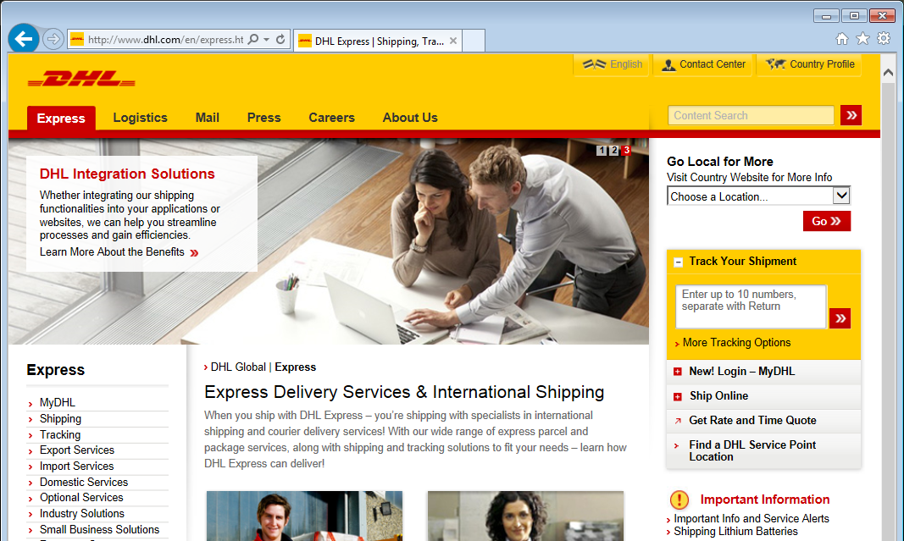
Example B2B application

Slide 13
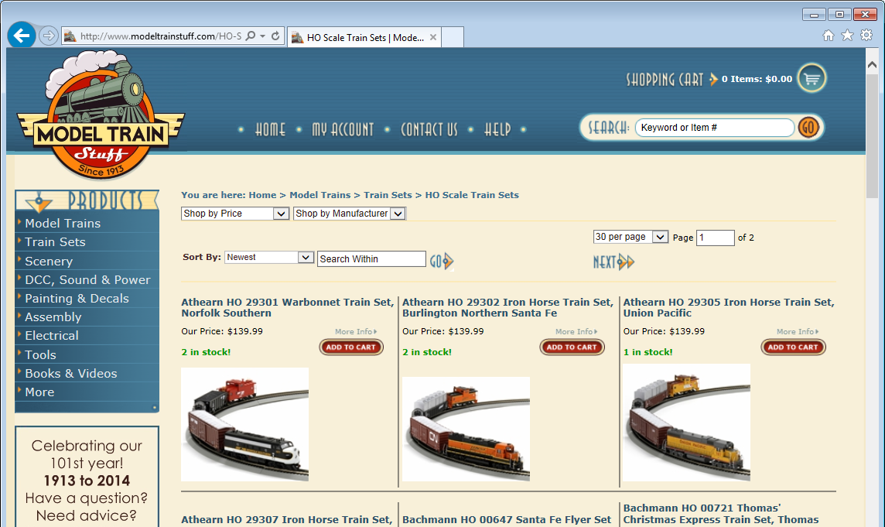
Example B2C application

Slide 14
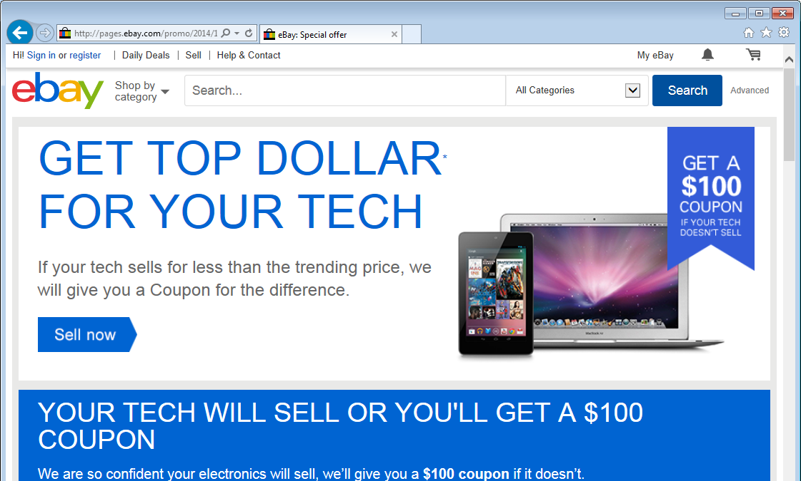
Example C2C / B2C application

Slide 15
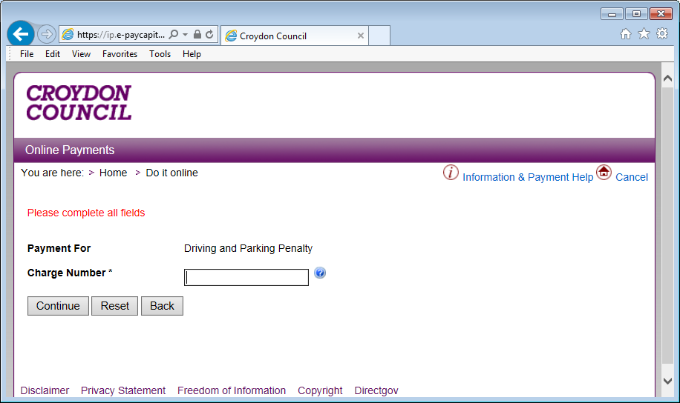
Example G2C application

Slide 16
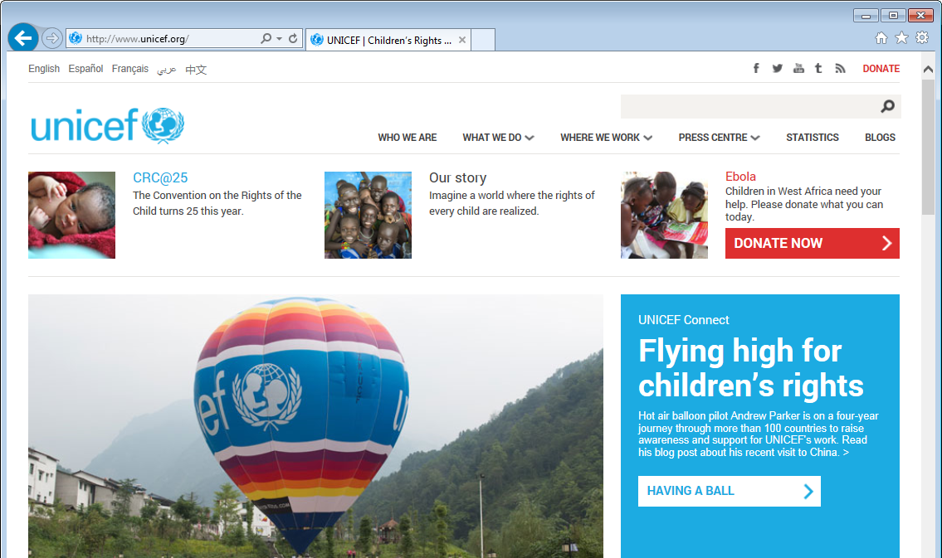
Example application in charity domain

Slide 17
Classifying Networked e-Business
Objects dimension

Slide 18
Objects dimension
Five basic e-business object classes:
physical goods are tangible goods which are physically exchanged between parties
digital goods are intangible goods which are electronically exchanged between parties
services are activities that one party specifically performs for another party
financial goods are sums of money or guarantees for the later delivery of a sum of money
hybrid objects are combinations of the above

Slide 19
Physical goods
The physical goods class can be refined into:
discrete goods: goods that are exchanged on a per piece basis, e.g.:
books, music CD’s
office furniture
bulk goods: goods that are exchanged in large quantities on a per volume or per weight basis, e.g.:
crude oil
bulk food like unprocessed grain

Slide 20
Digital goods
The digital goods class can be refined into:
digital content: copies of published and catalogued (multi-media) content , e.g. e-books, digital music, on-demand movies
digital information: on-demand produced informational data, e.g. electronic weather forecasts, on-demand stock analyses
software: copies of software products, such as word processors, multi-media players of bookkeeping systems

Slide 21
Services
The services class can be refined into:
physical services: activities that involve manipulation of physical objects that are not exchanged goods, e.g.:
air transportation
car washing
digital services: activities that do not involve manipulation of physical objects, e.g.:
financial services
shopping advice, agenda management

Slide 22
Classifying Networked e-Business
Time Scopes dimension

Slide 23
Time scopes dimension
Four classes of time scopes:
static: e-business collaboration in a scenario is long-lasting (or even permanent)
semi-dynamic: e-business collaborations are changed periodically, but not on the basis of individual orders
dynamic: e-business collaborations are determined for each individual e-business order
ultra-dynamic: collaborations are changed during the execution of an individual e-business order

Slide 24
Time scopes
Ultra-
dynamic
Dynamic
Semi-dynamic
Static
E-Business Order
1 10 100 1000 10,000

Slide 25
Partner selection decisions
Partner selection decisions are at different levels in four classes of time scopes:
static: strategic level decisions →
semi-dynamic: tactic level decisions →
dynamic: operational level decisions →
ultra-dynamic: small-scale operational level decisions

Slide 26
Classifying Networked e-Business
Case studies

Slide 27
POSH Scenario Classification
POSH classification in three dimensions:
Parties:
B2B: business clients
B2C: private clients
Objects:
discrete goods: furniture, equipment, supplies
hybrid objects: discrete goods + related services
Time scopes:
dynamic: individual orders
semi-dynamic: project-based orders

Slide 28
TTU Scenario Classification
TTU classification in three dimensions:
Parties:
B2B: business clients
Objects:
digital services: translation & interpretation
Time scopes:
semi-dynamic: relationships with clients
dynamic: individual orders
ultra-dynamic: real-time change of service provider?

Slide 29
TraXP Scenario Classification
TTU classification in three dimensions:
Parties:
B2B: business travelers
B2C: private travelers
Objects:
digital services: seamless traveling
Time scopes:
semi-dynamic: relationships with clients
highly competitive market
TraXP tries to move towards static time scope

Slide 30
Classifying Networked e-Business
Conclusions

Slide 31
Conclusions
Classification of e-business scenarios required for analysis of external characteristics
Using three dimensions:
Parties
Objects
Time scopes
Positioning scenarios in three-dimensional e-business classification space

Slide 32
Summary of values in classification dimensions
Parties
B2B
B2C
Objects
Physical Goods
Digital Goods
Time Scopes
C2C
G2B
G2C
Services
Financial Goods
Hybrid Objects
Static
Semi-dynamic
Dynamic
Ultra-dynamic

